Slide 1
SQL Project
Tweet Engagement Metrics dataset (Kaggle)
Kaggle Link : https://lnkd.in/ghyYMhP3

Slide 2
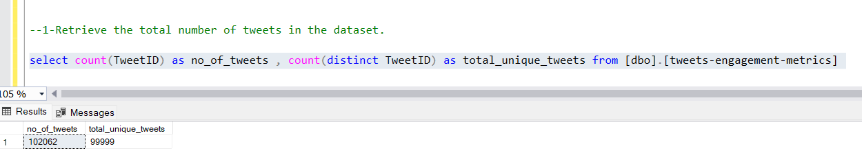
1-Retrieve the total number of tweets in the dataset.

Slide 3
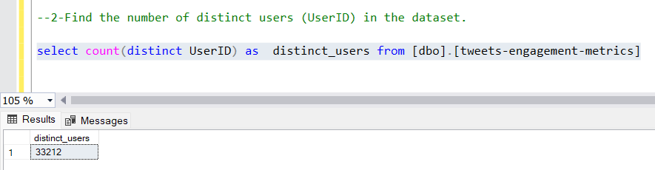
2-Find the number of distinct users (UserID) in the dataset.

Slide 4
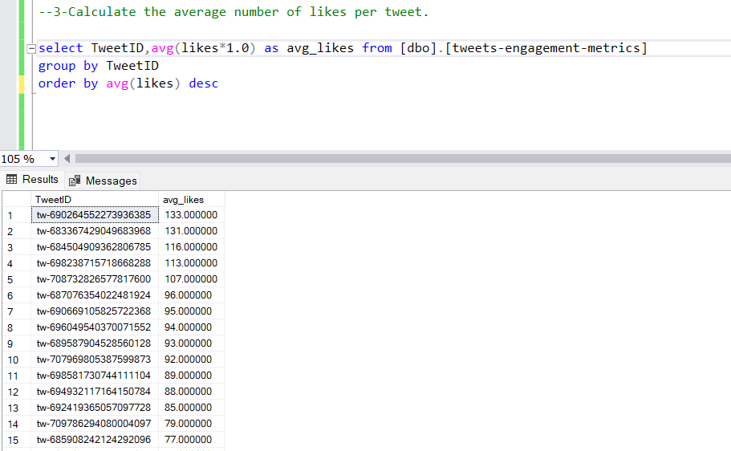
3-Calculate the average number of likes per tweet.

Slide 5
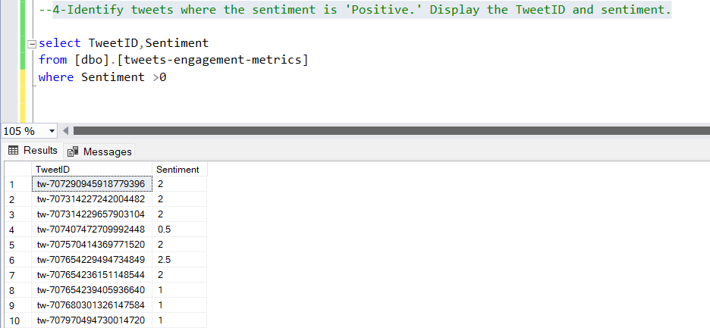
4-Identify tweets where the sentiment is 'Positive.' Display the TweetID and sentiment.

Slide 6
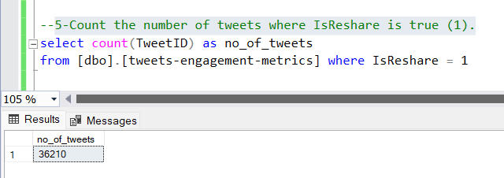
5-Count the number of tweets where IsReshare is true (1).

Slide 7
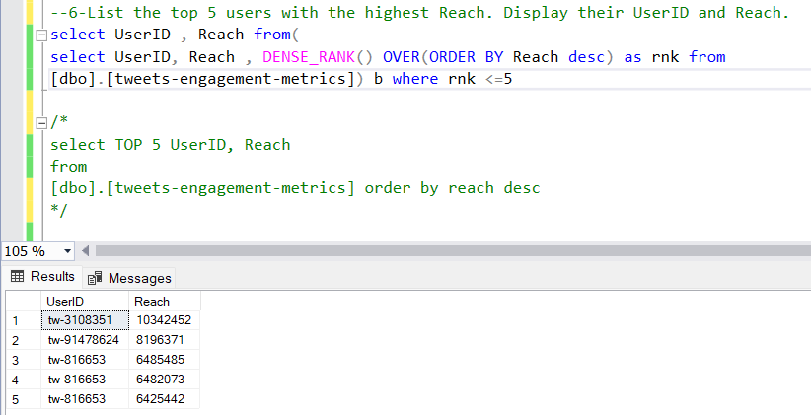
6-List the top 5 users with the highest Reach. Display their UserID and Reach.

Slide 8
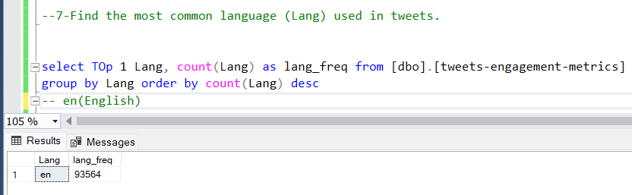
7-Find the most common language (Lang) used in tweets.

Slide 9
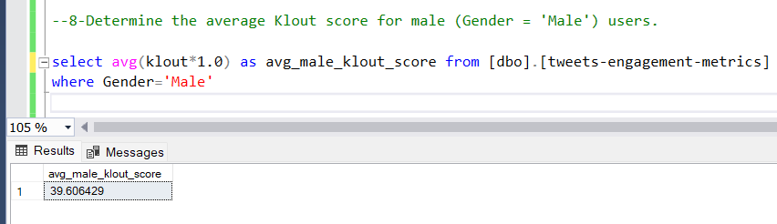
8-Determine the average Klout score for male (Gender = 'Male') users.

Slide 10
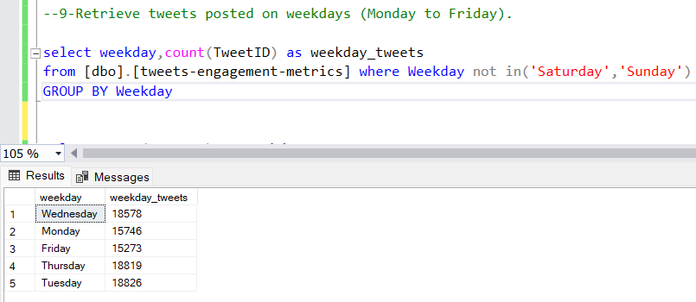
9-Retrieve tweets posted on weekdays (Monday to Friday).

Slide 11
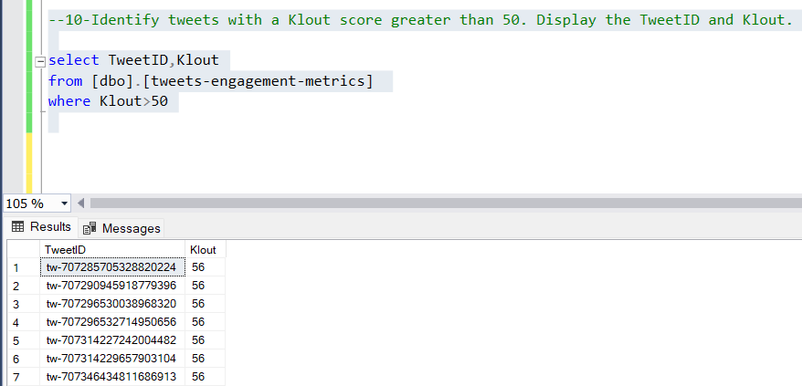
10-Identify tweets with a Klout score greater than 50. Display the TweetID and Klout.

Slide 12
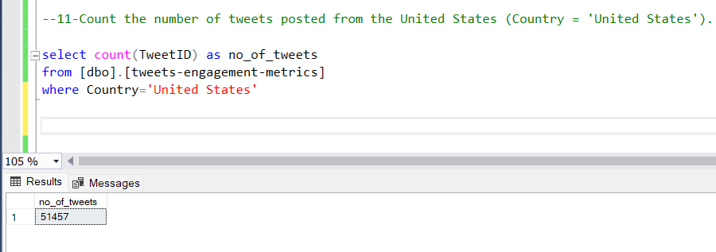
11-Count the number of tweets posted from the United States (Country = 'United States').

Slide 13
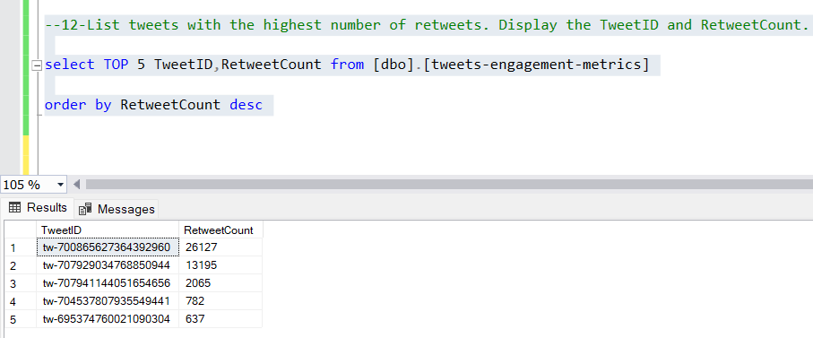
12-List tweets with the highest number of retweets. Display the TweetID and RetweetCount.

Slide 14
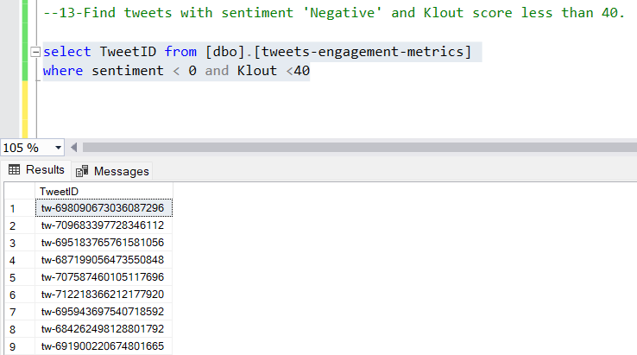
13-Find tweets with sentiment 'Negative' and Klout score less than 40.

Slide 15
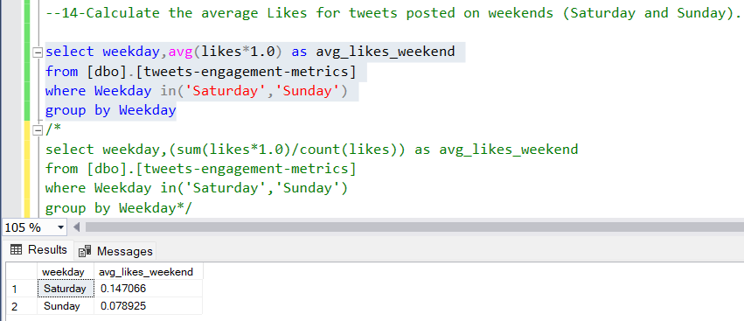
14-Calculate the average Likes for tweets posted on weekends (Saturday and Sunday).

Slide 16
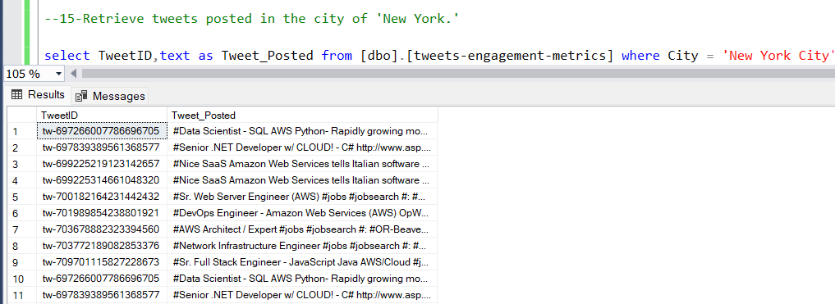
15-Retrieve tweets posted in the city of 'New York.'

Slide 17
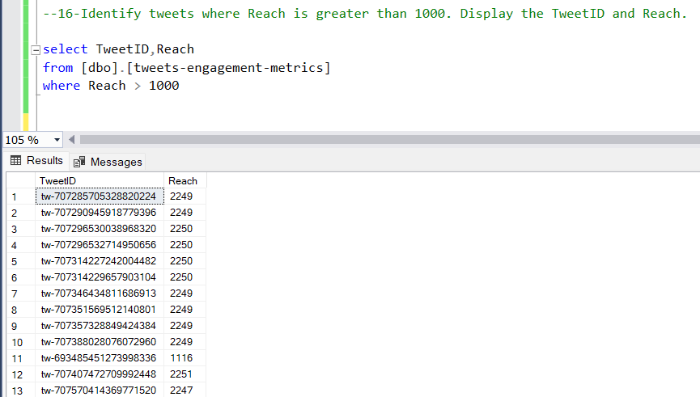
16-Identify tweets where Reach is greater than 1000. Display the TweetID and Reach.

Slide 18
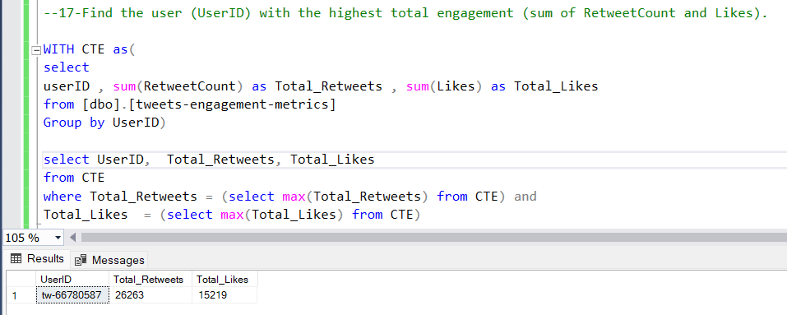
17-Find the user (UserID) with the highest total engagement (sum of RetweetCount and Likes).

Slide 19
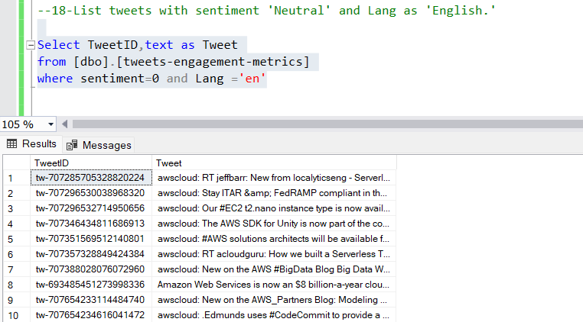
18-List tweets with sentiment 'Neutral' and Lang as 'English.'

Slide 20
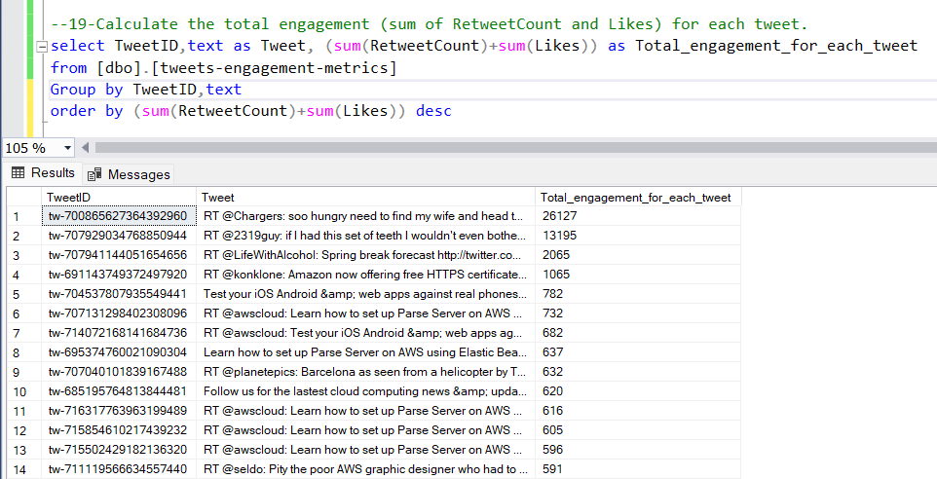
19-Calculate the total engagement (sum of RetweetCount and Likes) for each tweet.

Slide 21
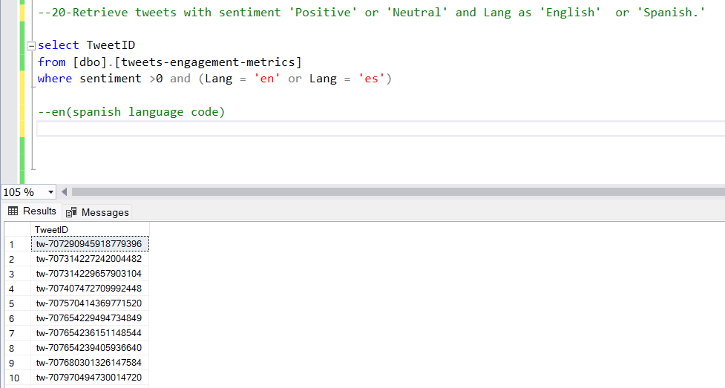
20-Retrieve tweets with sentiment 'Positive' or 'Neutral' and Lang as 'English' or 'Spanish.'

